Slide 1
Design Kickstarter: MCUs and Circuits
5/26/2026
Anna Chen | CE29

Slide 2
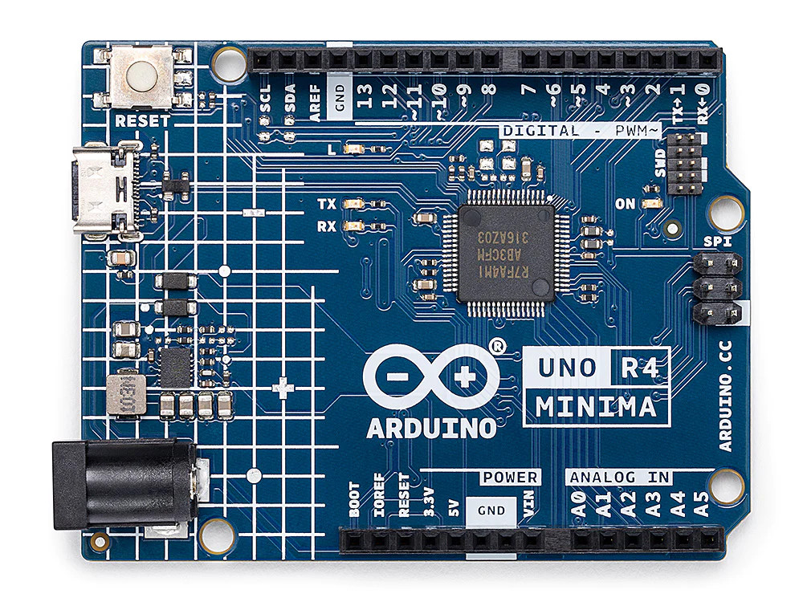
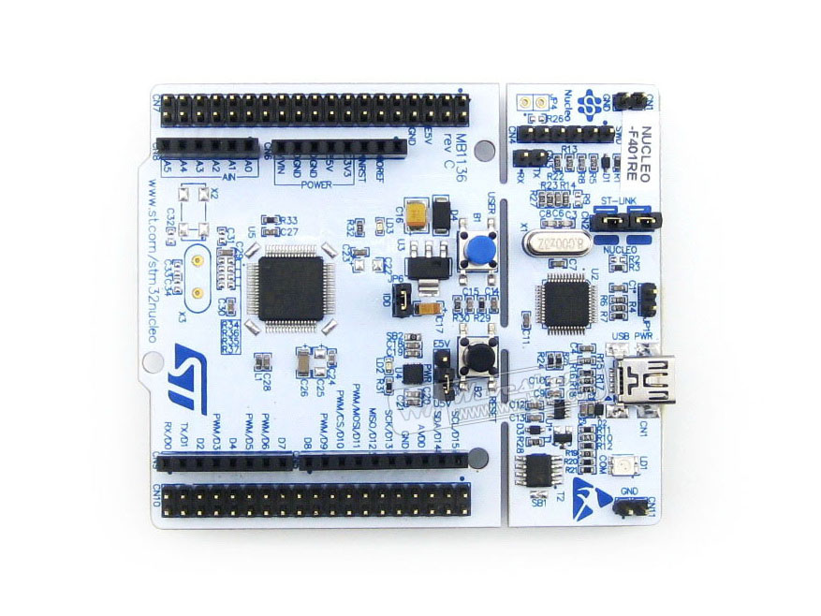
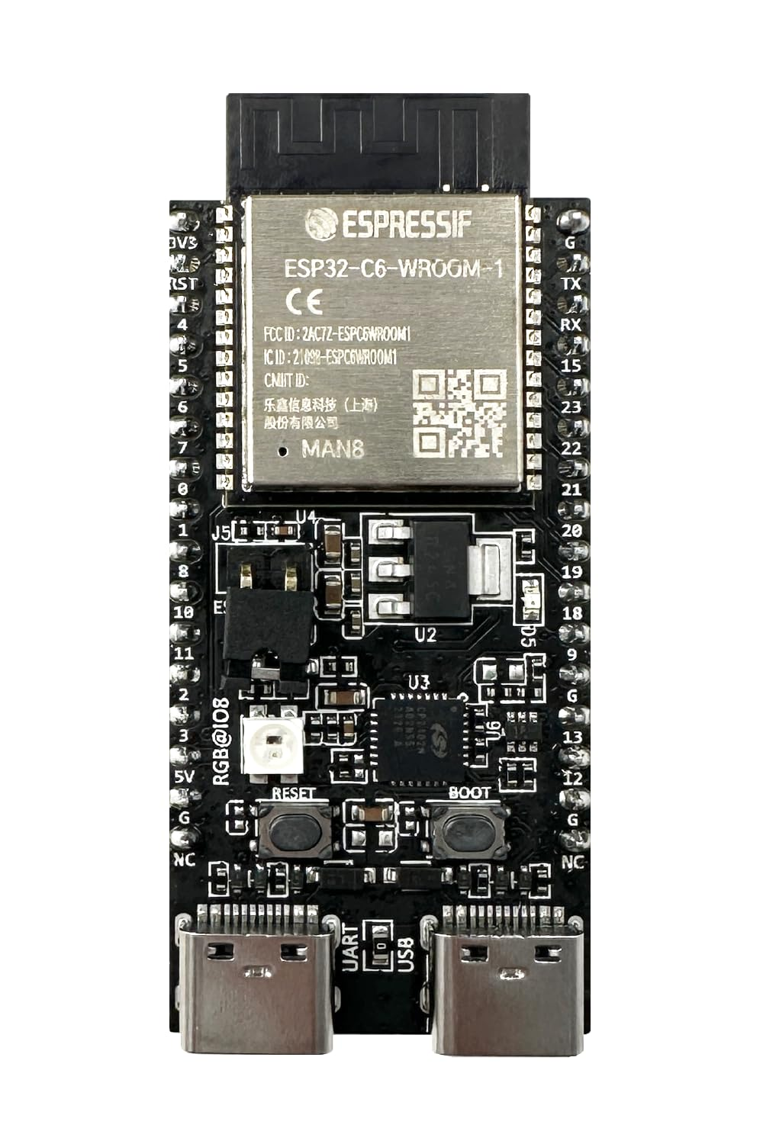
Microcontrollers (MCUs)
Small, self-contained computer on a single chip
Acts as a brain for embedded systems – specialized computer system for a dedicated task in a larger mechanical or electrical device
No operating system - highly efficient and inexpensive
Arduino UNO R4 Minima
STM32 Nucleo-F401RE
ESP32-C6-WROOM-1
Design Kickstarter: MCUs and Circuits
PAGE 2

Slide 3
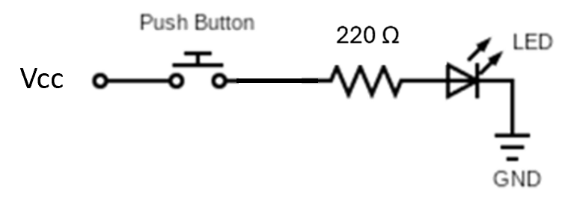
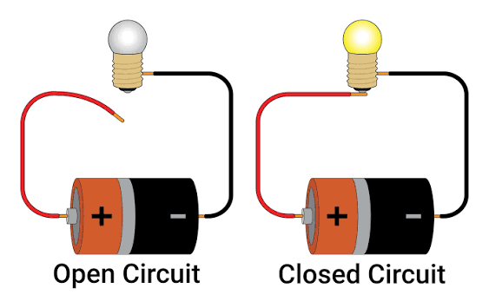
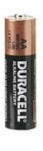
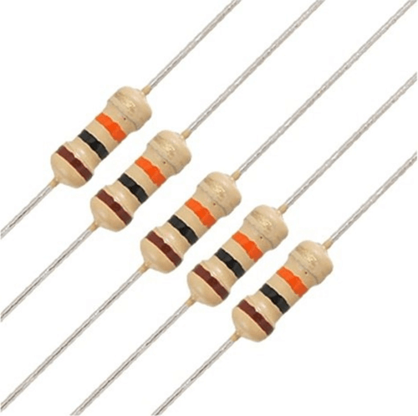
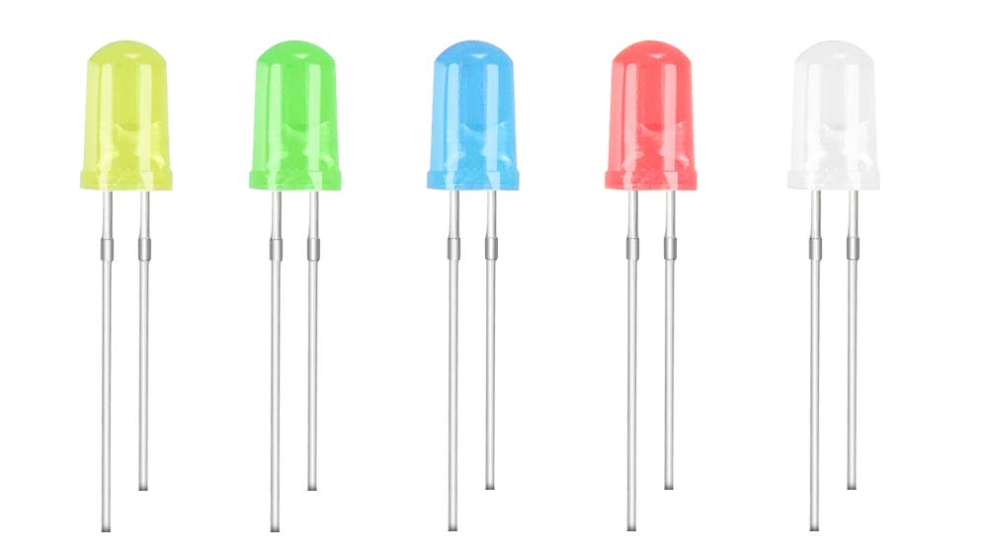
Circuits
Circuit – Closed path that allows electric current to flow
Typically contains a power source (Voltage), conductive pathways (wires) and a load (resistor, lightbulb, etc.)
Circuits can be open, closed, or short (occurs when too much current goes through a wire)
Power Sources
Loads
Design Kickstarter: MCUs and Circuits
PAGE 3

Slide 4
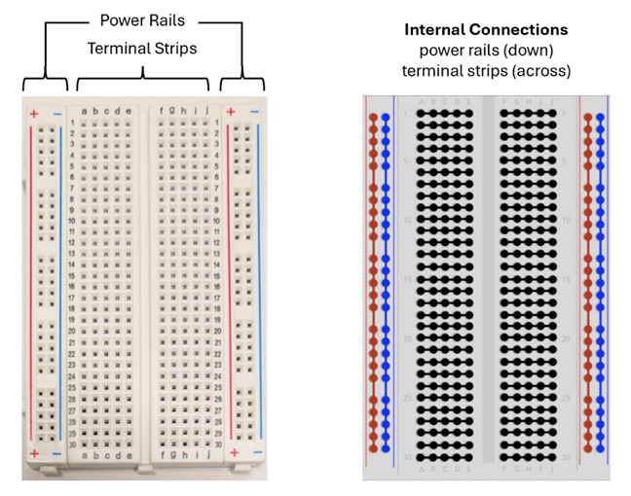
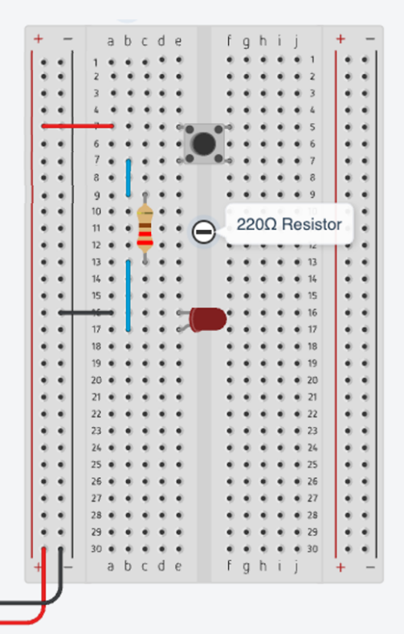
Breadboards
Used to make circuits
Consists of conductive strips underneath a plastic surface with holes
Insert components to make connections without soldering
Power rails: typically used for power (3.3V or GND)
Example wiring:
Design Kickstarter: MCUs and Circuits
PAGE 4

Slide 5
Arduino Kit Components
In each Arduino Kit, you should have the following components:
1x Arduino R4 Uno Minima
2x Push Buttons
2x LEDs
1x Breadboard
2x 220Ω Resistor
2x 10kΩ Resistor
1x Potentiometer
12x Male-Male Jumper Wires
If you are missing anything, please speak to one of our staff
Design Kickstarter: MCUs and Circuits
PAGE 5

Slide 6
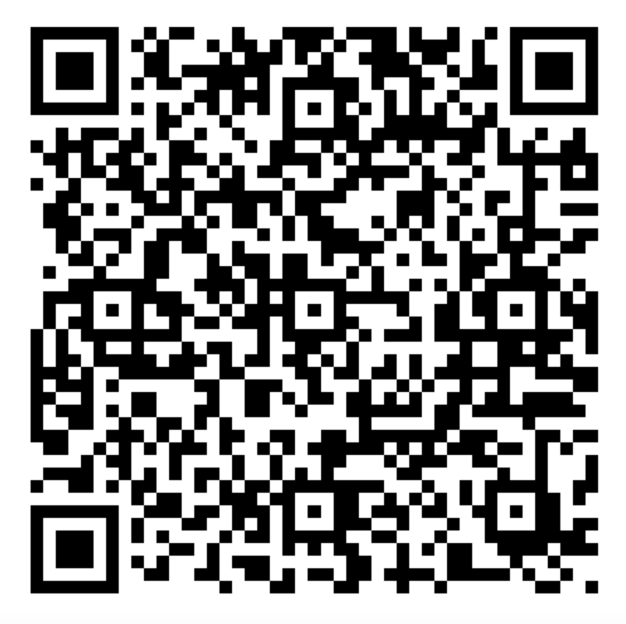
Workshop Link
Scan the QR code to start this workshop
Or use this link: https://drive.google.com/file/d/1CaSuTAYhEK6ft-aZSbV-zcHXJN2Qgprj/view?usp=sharing
Design Kickstarter: MCUs and Circuits
PAGE 6

Slide 7
Design Kickstarter: MCUs and Circuits

